Slide 1
The Digital Future of Healthcare in the NHS
Professor Stephen Powis
National Medical Director
24th January 2020
Danish Organisation of Medical Societies Annual Conference
Copenhagen

Slide 2
Disclosure I have no personal or professional financial relationships or interests with any proprietary entity producing healthcare goods/or services

Slide 3
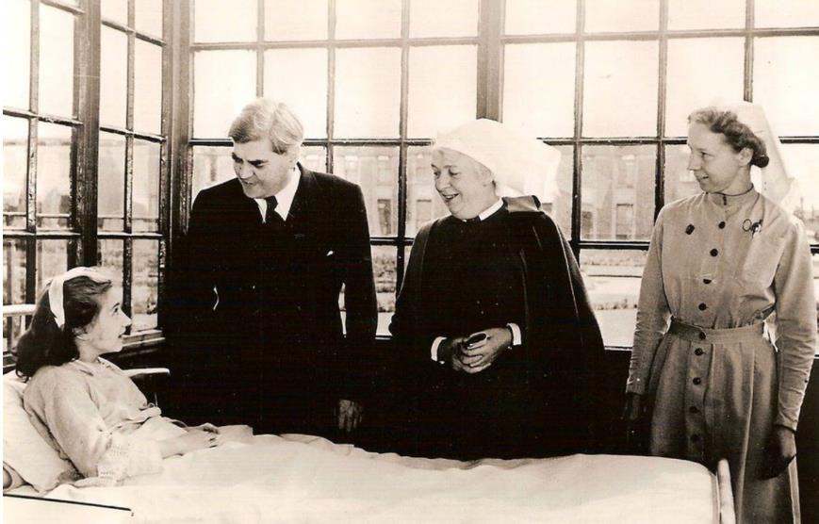
The National Health Service

Slide 4
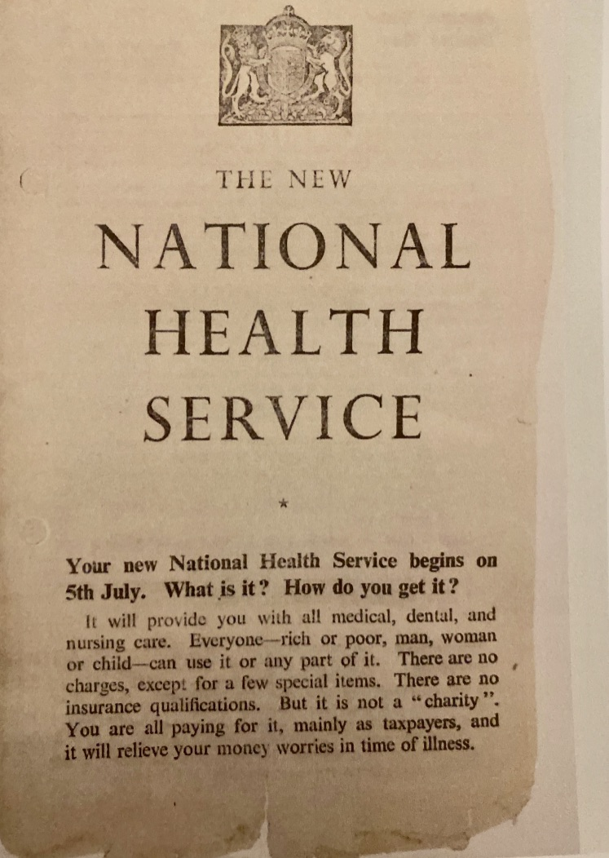

Slide 5
We are living, on average, 14 years longer than we were in 1948 - but our health needs have become increasingly complex
In 1948 medical knowledge doubled every 50 years – by 2020 it is estimated it will double every 73 days

Slide 6
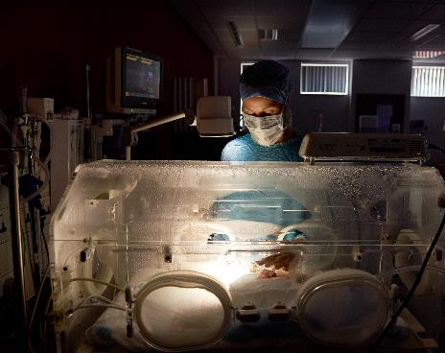
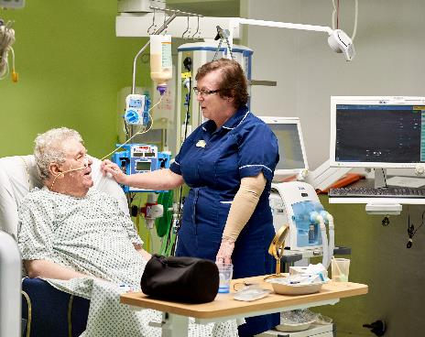
The NHS today…
1.2 million employees
1m patients every 36 hours
£123bn budget
340m GP visits per year
Notes:
*The NHS is the world’s fifth-largest employer, behind the US department of defence (3.2m), Chinese People’s Liberation Army (2.3m), Walmart (2.3m), and McDonald's (1.9m).

Slide 7
Despite pressures - the NHS is efficient, equitable, and continues to improve
The system operates under considerable pressure
Helps over 20 million mental health service users a year¹
Conducts 5 million GP consultations per week²
Serves over 1 million patients³, delivers 1,900 babies⁴, admits 64,000 people to A&E¹, completes 28,000 operations a day¹
We continue to improve in specific areas
Waiting times are lower than a decade ago (although slowly rising)⁷
Annual cancer survival rates are improving⁸
Heart attack and stroke deaths have tumbled (total CVD mortality is down 68% since 1980)⁷
The NHS is more efficient than the rest of the economy
In 2016-17 healthcare productivity grew by 3.0%, more than treble the rate achieved across the wider UK economy

Slide 8
Current challenges…
Ageing population and shifting disease burden to long term conditions
Workforce – 100,000 vacant positions
Social care – severe financial and workforce pressures
Capital – backlog of improvements required
EU Exit

Slide 9
Health Care System Performance Rankings
 | AUS | CAN | FRA | GER | NETH | NZ | NOR | SWE | SWIZ | UK | US
OVERALL RANKING | 2 | 9 | 10 | 8 | 3 | 4 | 4 | 6 | 6 | 1 | 11
Care Process | 2 | 6 | 9 | 8 | 4 | 3 | 10 | 11 | 7 | 1 | 5
Access | 4 | 10 | 9 | 2 | 1 | 7 | 5 | 6 | 8 | 3 | 11
Administrative Efficiency | 1 | 6 | 11 | 6 | 9 | 2 | 4 | 5 | 8 | 3 | 10
Equity | 7 | 9 | 10 | 6 | 2 | 8 | 5 | 3 | 4 | 1 | 11
Health Care Outcomes | 1 | 9 | 5 | 8 | 6 | 7 | 3 | 2 | 4 | 10 | 11
Source: Commonwealth Fund analysis.

Slide 10
‘These give us a glimpse of what the future of the whole NHS could be, which is why in the year of the NHS’s 70th birthday I want to empower staff to offer patients modern healthcare more widely and more quickly,” I’m delighted that Dr Topol is kicking off this review – ensuring the NHS is at the forefront of life-saving, life-changing care across the globe for decades to come.’

Slide 11
‘Although it’s hard to predict the future, we know artificial intelligence, digital medicine and genomics will have an enormous impact for improving the efficiency and precision in healthcare.
Our review will focus on the extraordinary opportunities to leverage these technologies for the healthcare workforce and power a sustainable and vibrant NHS’

Slide 12
‘These developments will change patients’ lives, change how clinicians work and change how healthcare services are delivered. This is happening now and the NHS is ideally placed to take it further, faster and wider if we act to give our staff the skills and knowledge they need to make them the norm across the NHS.’

Slide 13
Topol key findings
Citizens and patients should be engaged and educated in digital healthcare and genomics
Healthcare professionals should be better trained in the use of digital technologies and genomic data
Health leaders and organisations should be better prepared for the safe and effective adoption of digital technology including AI
A more specialist workforce should be developed to support digital healthcare
Wherever possible, new technologies should enable staff to gain more time to care

Slide 14
‘I’ve spent most of my Ministerial career driving the proper use of digital technology. From transformation of parts of government technology, to promoting the use of technology across the economy, to legislating to protect us from the new risks it brings, to child safety and privacy. Now I intend to bring that knowledge and experience, and frankly my unsurpassable enthusiasm for tech to Britain’s health and social care system.’

Slide 15
Published January 2019

Slide 16
The NHS Long Term Plan 2019
1
Do things differently, through a new service model
2
Take more action on prevention and health inequalities
3
Improve care quality and outcomes for major conditions
4
Ensure that NHS staff get the backing that they need
5
Make better use of data and digital technology
6
Ensure we get the most out of taxpayers’ investment in the NHS

Slide 17
A new vision of care…
DHSC tech vision
NHS X
…transformed by technology

Slide 18
NHSX Missions
Reduced burden on staff, so they can focus on patients
Citizens have tools to access information and services directly
Clinical information can be safely and digitally accessed
Improvement of patient safety across the NHS
Increased NHS productivity
Notes:
- Single electronic identity for staff, and “Single sign on” for staff
- “Bleep” alternatives
- The NHS App
- “What you need to know about me”
- Care Plans on SCR/App
- Early LHCR wins
- Reducing face to face appointments
- Bookings, referrals and appointments management
eRostering
- Interoperable medication standards
- Assured citizen identity

Slide 19
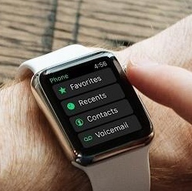
Information, tools and services for citizens
The NHS App is a new simple, secure way for people to access a range of NHS services
The NHS website is a trusted health website providing trusted information to 1.3 million visitors daily, 40m+ every month
NHS login makes it easier and quicker for people to access digital tools and services
Digital maternity delivers a digital pathway of care from conception to post-natal improving the experience of women accessing care
Widening digital participation helps the millions of people who lack the skills and means to use digital health services
Digital child health ensures key health information can be shared appropriately with all those involved in the care of a child
111 online allows people to get urgent healthcare online, using their laptop, smartphone or other device 100% coverage
Personal health records offer online, secure ways for patients to manage their health and care
The NHS Apps Library is a public facing service providing people with access to trusted digital tools, 1m hits, 80 apps
WiFi providing free public WiFi across the NHS Estate – 54m people ministerial commitment achieved
Notes:
Additionally we have delivered NHS WiFi will make sure everyone can access free, secure and consistent WiFi services at NHS sites across England.

Slide 22
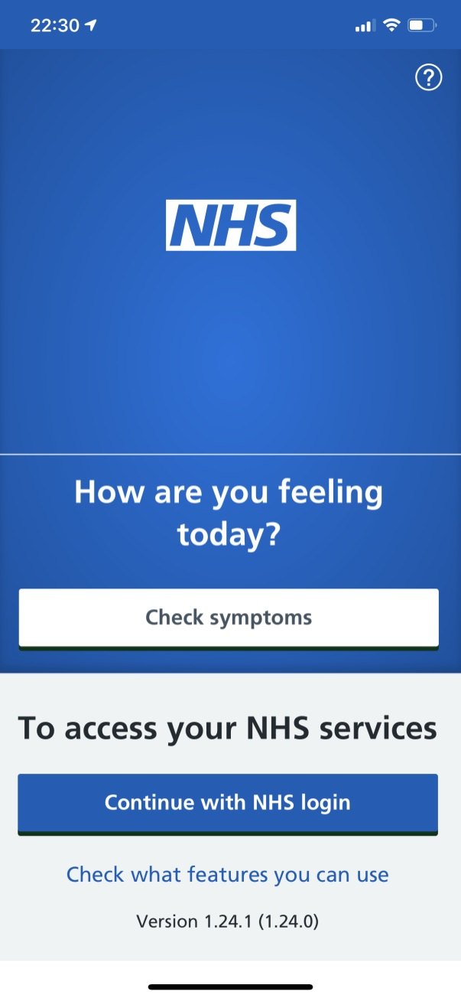
The NHS App enables people to:
check their symptoms using the health A-Z on the NHS website
find out what to do when they need help urgently using NHS 111 online
Register as an organ donor
Choose whether the NHS uses their data for research and planning
If their GP practice is connected to the app, they can register and verify their identity so they can:
book and manage appointments at their GP practice
order their repeat prescriptions
view their GP medical record securely

Slide 23
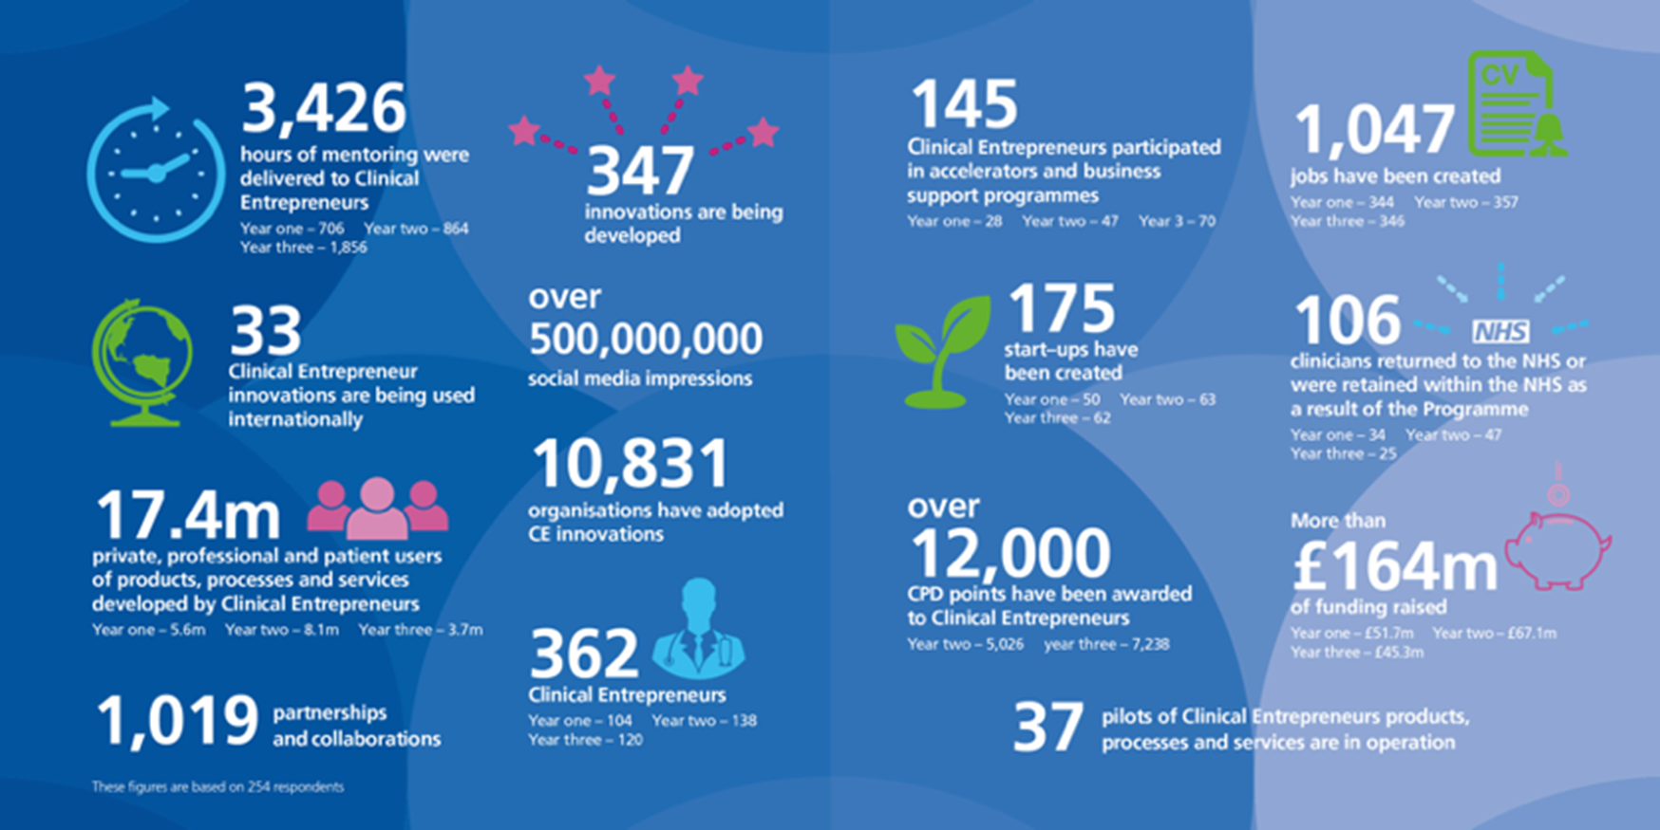
The NHS Clinical Entrepeneurs Programme

Slide 24
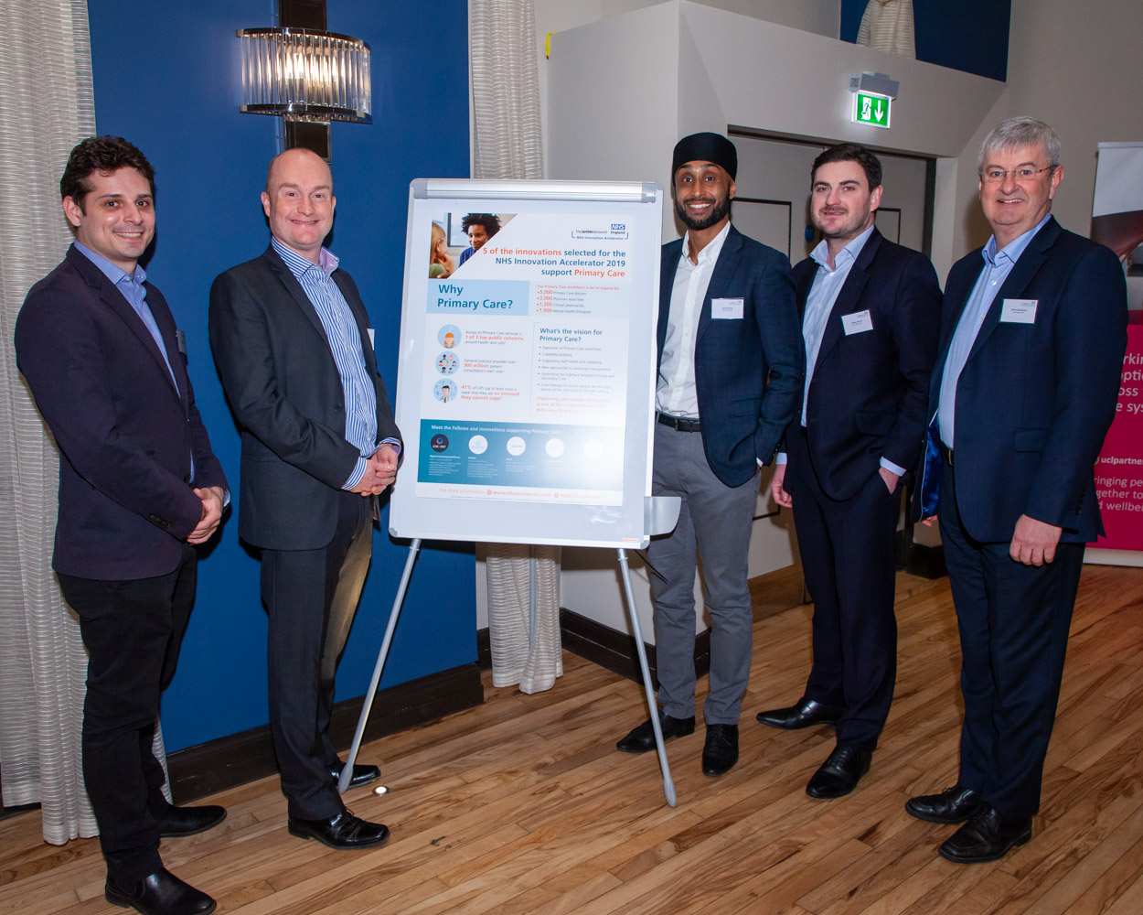
The NHS Innovation Accelerator
Award-winning NHS England initiative delivered in partnership with England’s 15 Academic Health Science Networks (AHSNs)
Supports the uptake and spread of high impact, evidence-based innovations across England’s NHS, benefitting patients, populations and NHS staff
Provides practical real time insights on spread to inform national strategy

Slide 25
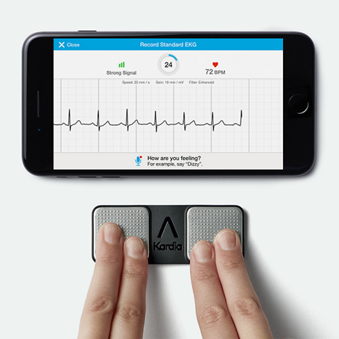
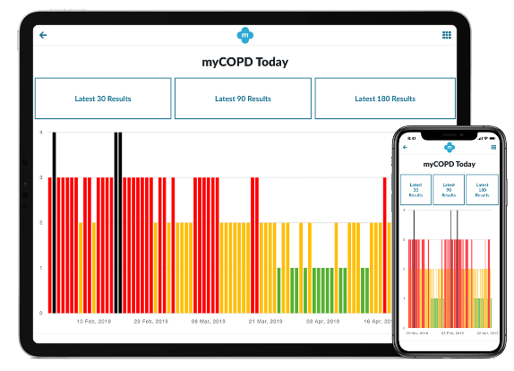
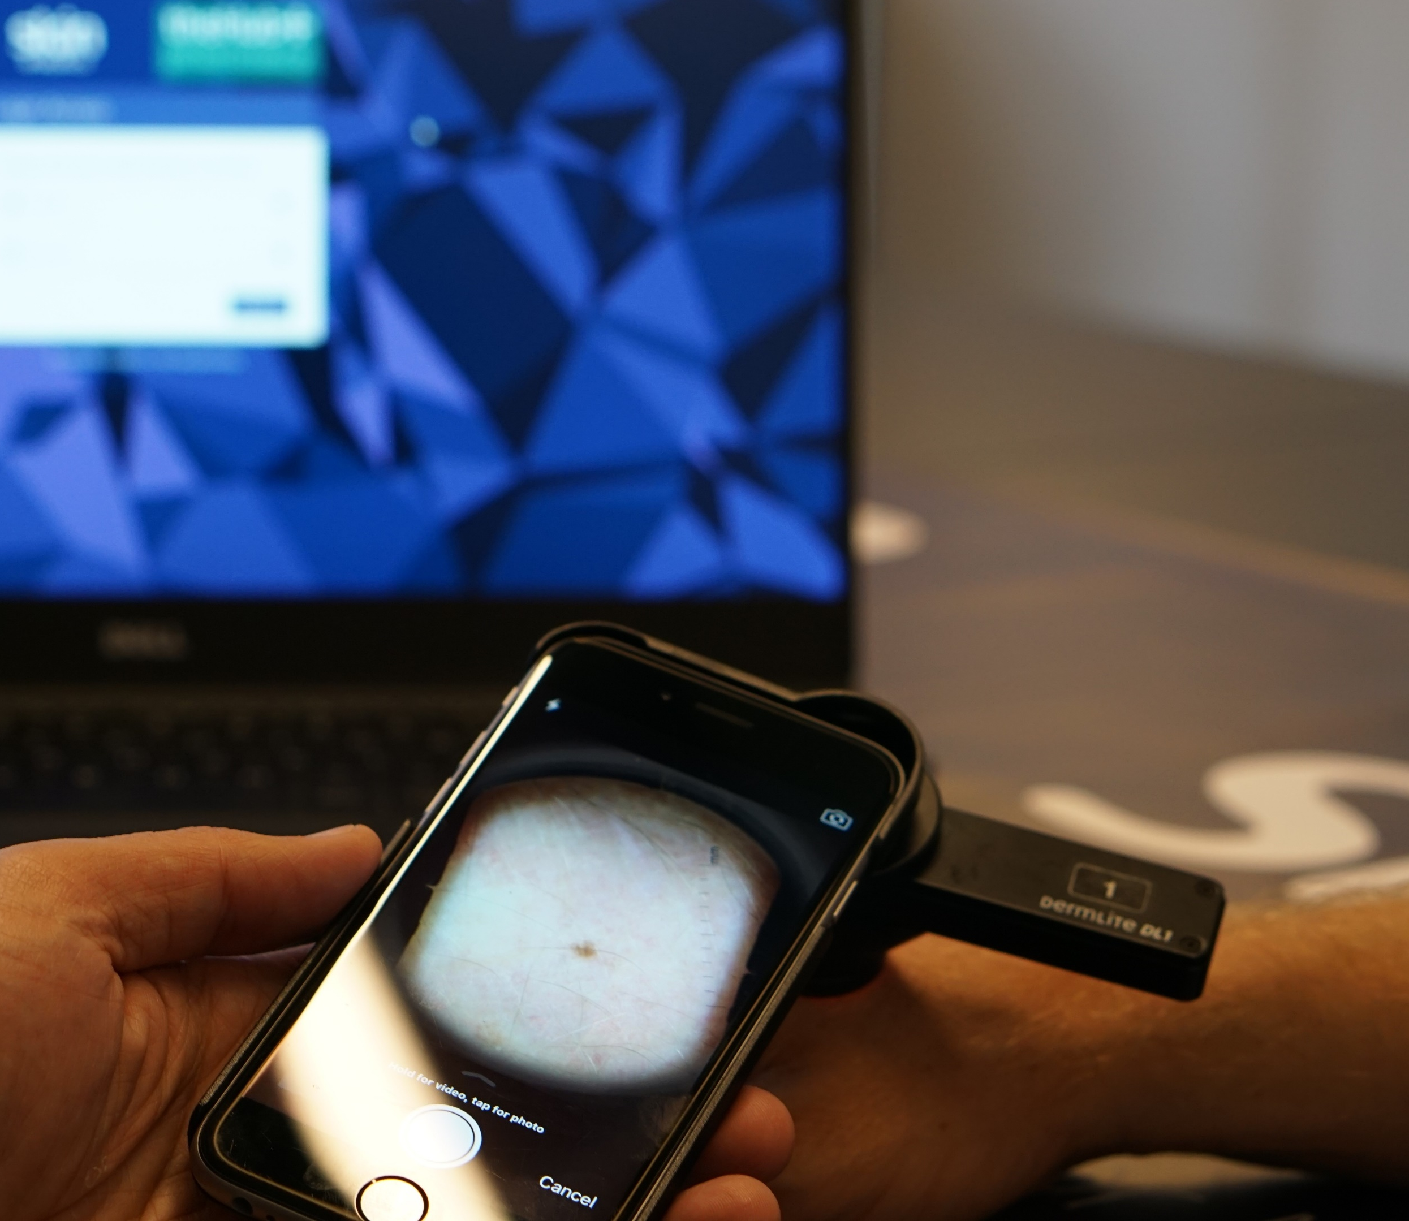
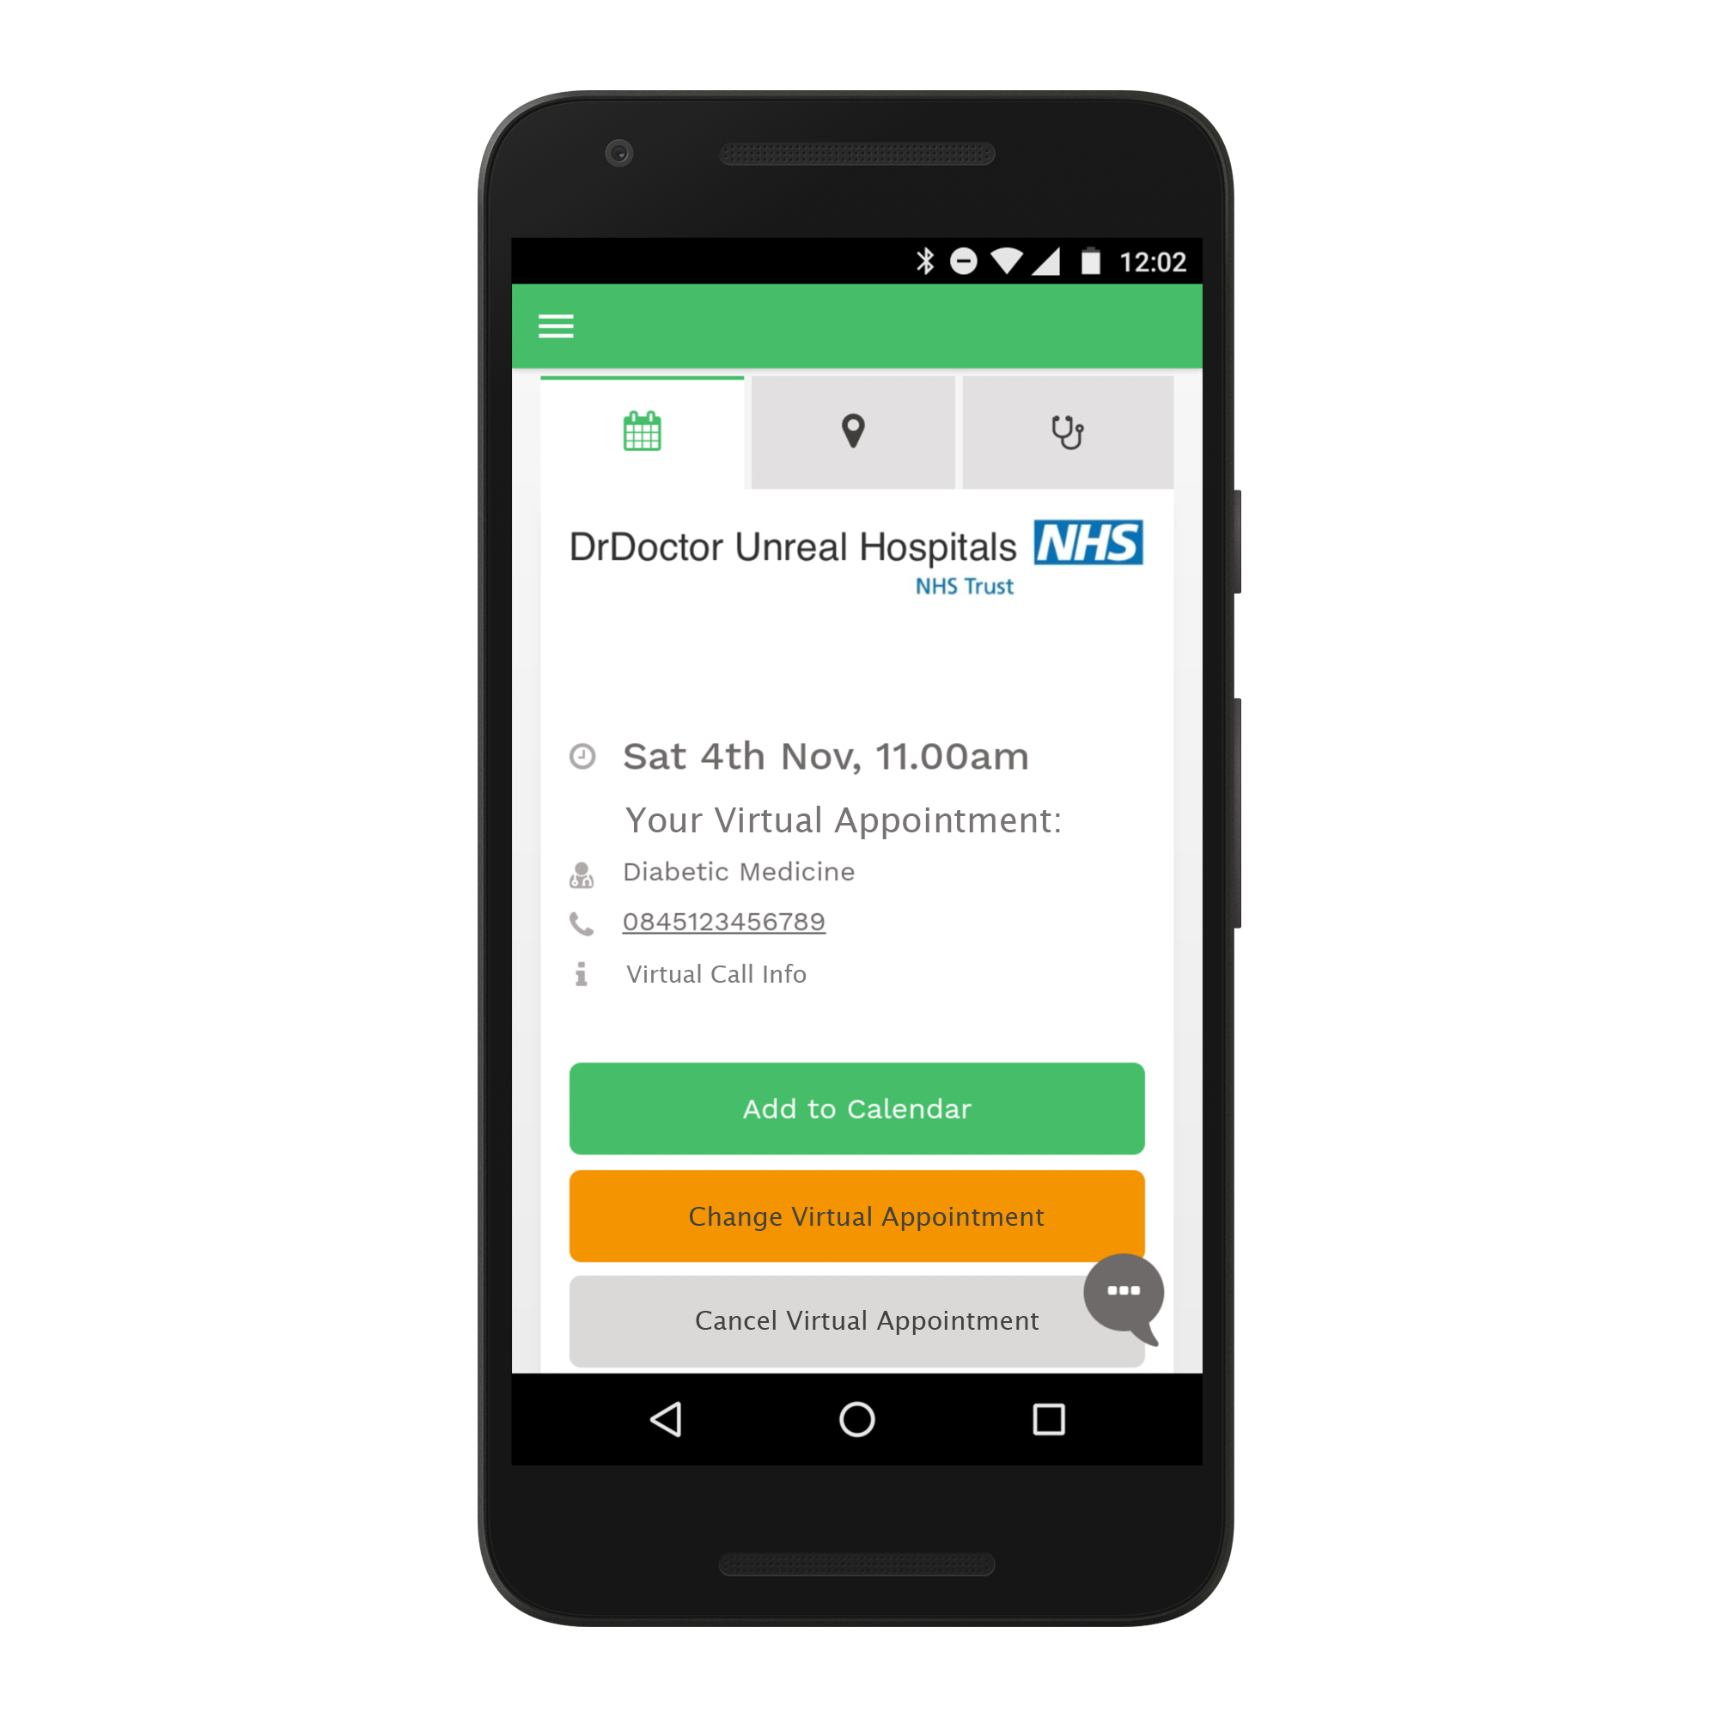
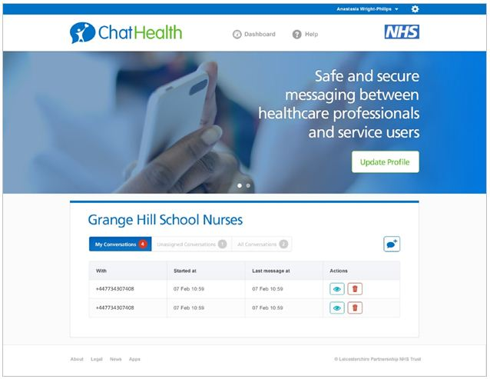
36 digital innovations supported

Slide 26
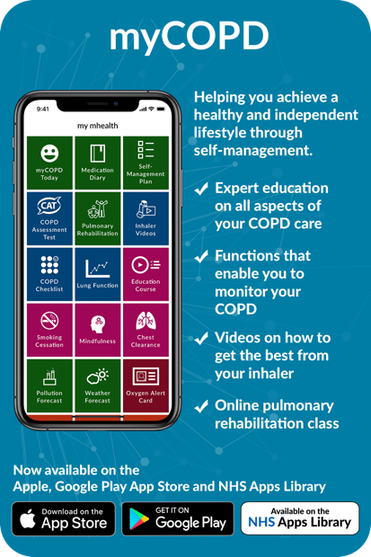
myCOPD
Joined the NIA in 2015
Proven to correct up to 98% of patient inhaler errors without clinical involvement
First ‘NHS approved’ app in the NHS Apps Library
Savings of +£200K for local health commissioners with average COPD population
Now being used across 113 NHS sites
International spread to USA and New Zealand

Slide 28
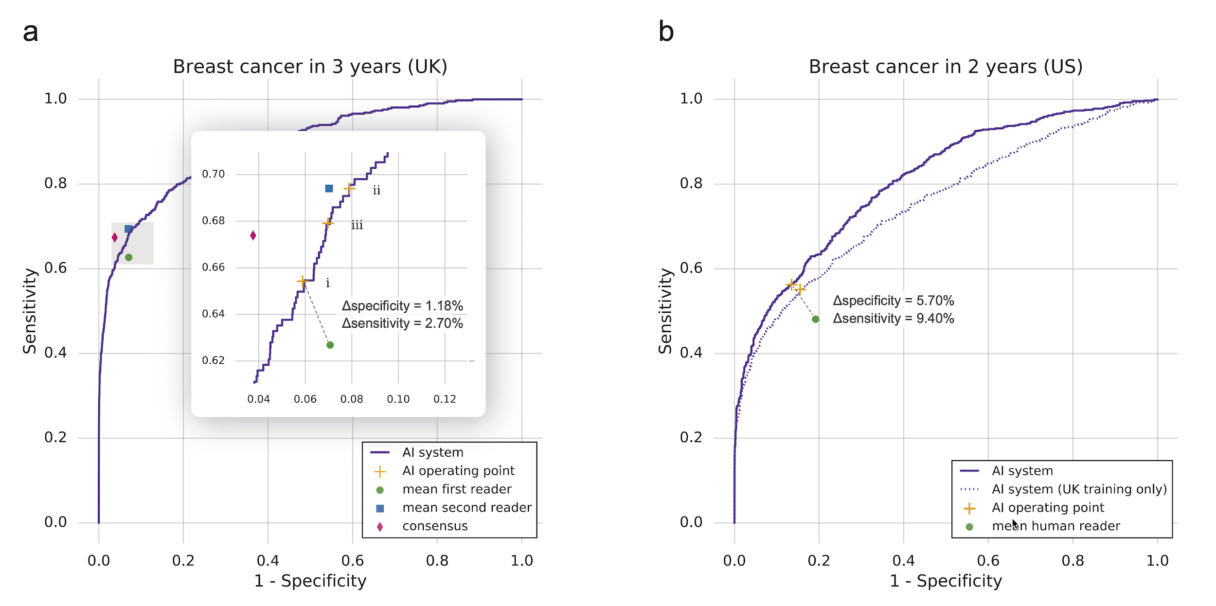
AI and breast screening

Slide 30
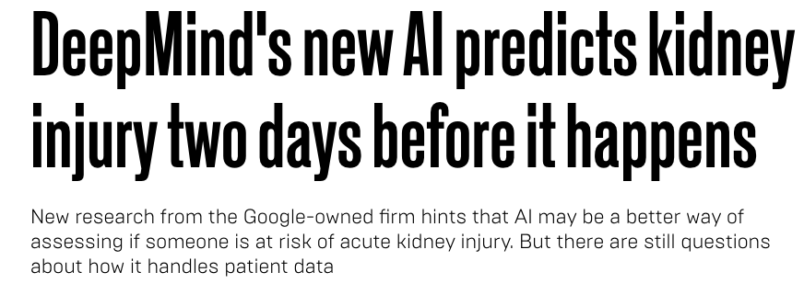

Slide 31
A clinically-led approach to reducing unwarranted variation in care through digitisation of clinical pathways within the electronic health record

Slide 32
Delivering best clinical outcomes by introducing
a standardised clinical algorithm for all children that present to ED with wheeze.
Step 1
Gateway Review
Step 2
Review future state on paper
Step 3
Design Future state and measurement plan in system
Step 4
Cerner Build
Prototype pathway
Step 5
Pathway team 1st review prototype build of pathway
Step 6
Pathway team 2nd review of prototype pathway
Step 7
Test Pathway in Cerner and Trust
Step 8
Pathway sign off
Cerner and Trust

Slide 33
Average Time (in minutes) to steroid administration from first medical assessment by week

Slide 34
Medicines safety metrics
Indicator 1 | Patients 65yrs old or over taking a Non-Steroidal Anti-Inflammatory Drugs (NSAID) and NOT taking a gastro-protective medicine. | Hospital admissions for GI bleed
Indicator 2 | Patients 18 years of age or over taking selected NSAID and taking either warfarin or a NOAC. | Hospital admissions for GI bleed
Indicator 3 | Patients 18 years of age or over taking selected warfarin or NOAC with an anti-platelet medicine and NOT taking gastro protective medicine | Hospital admissions for GI bleed
Indicator 4 | Patients 18 years of age or over taking aspirin and another anti-platelet medicine and NOT taking gastro protective medicine | Hospital admissions for GI bleed
Indicator 5 | Patients 18 years of age or over taking a NSAID, an ACE inhibitor/ARB and a diuretic | Hospital admissions for Acute Kidney Injury
Composite indicator | Medicines with a risk of GI Bleed – composite of Indicators 1-4 | Hospital admissions for GI Bleed

Slide 35
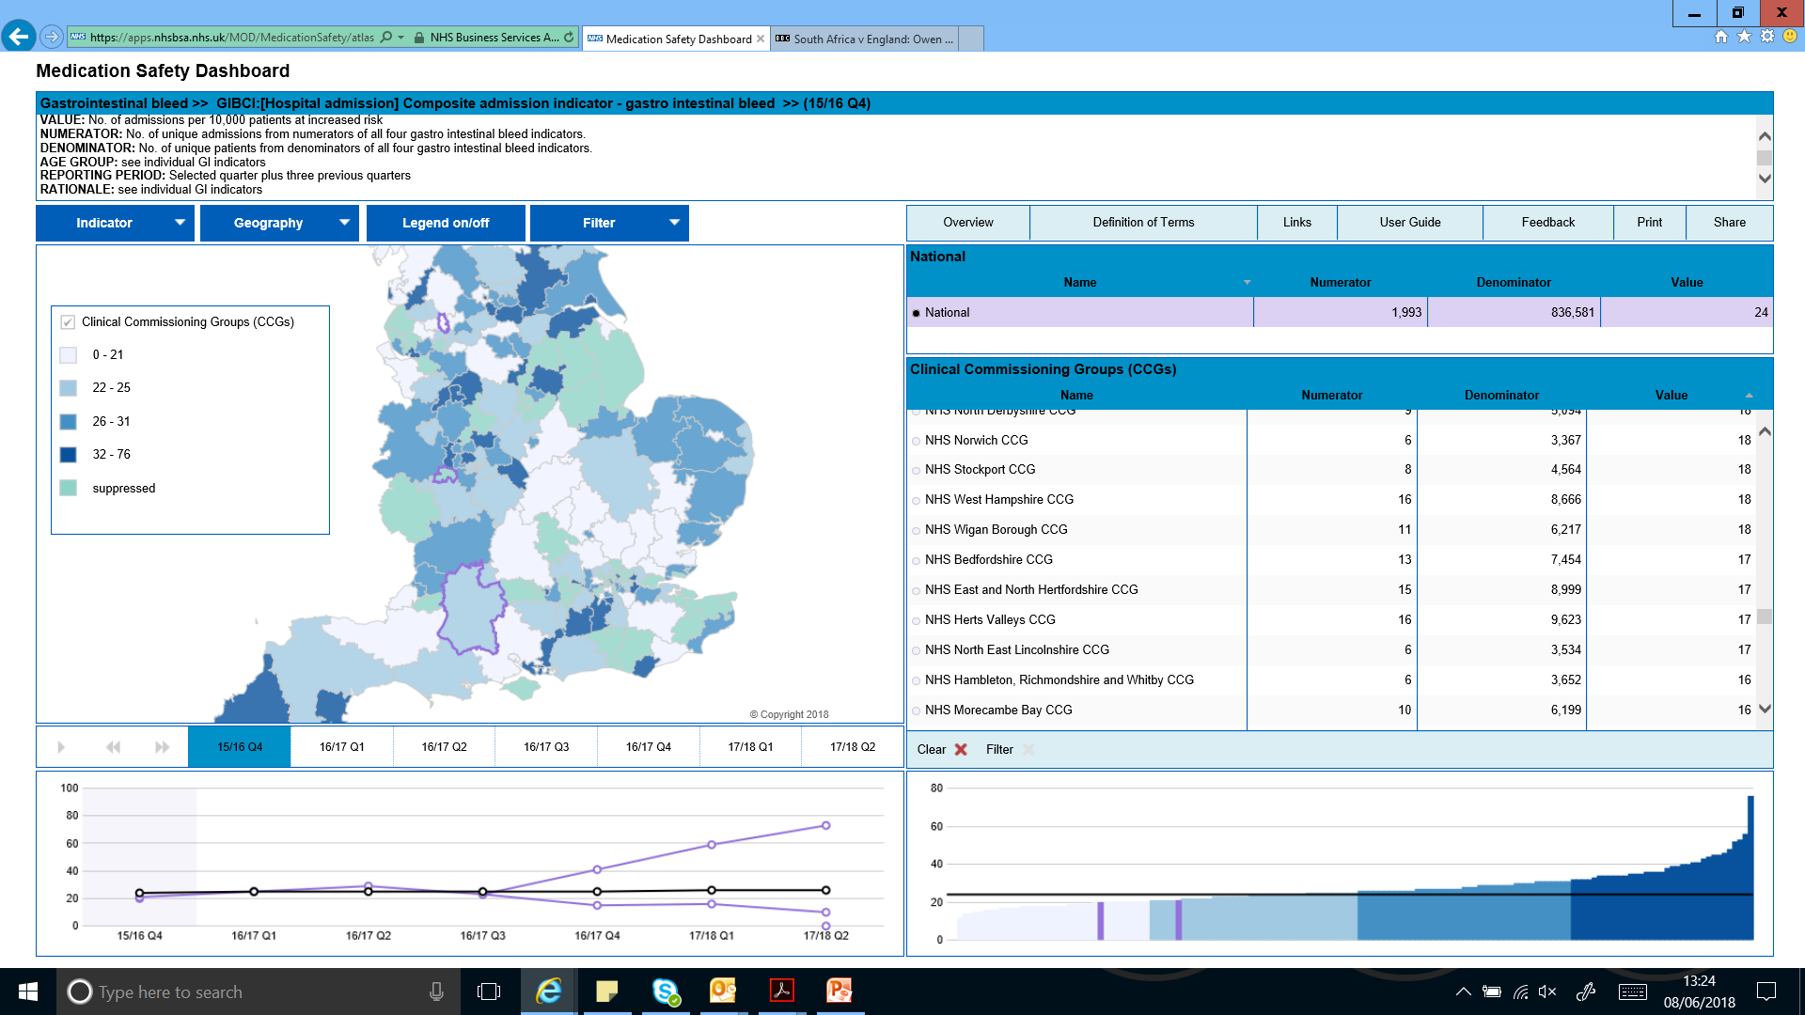

Slide 36
“Genomics is probably the biggest breakthrough in the last 50 years. For many years, it’s been talked about that medicine is going to be personalized. We’re finally starting to get there.”
Dr Eric Topol

Slide 37
The new national genomic infrastructure
Co-ordinated delivery across local networks
NHS Genomic Medicine Service Alliances (evolved NHS GMC structures)
Co-ordination and alignment across clinical genetics & genetic counselling services
Co-ordination of genomic medicine & ensuring equitable access to testing across clinical specialities
Patient engagement & involvement - shaping services, raising awareness of genomics
Research
facilitating access to genomic data and samples
Driving personalisation of care and medicines optimisation
Informed patients & clinical teams
National Genomic Testing service
Ongoing research & discovery
NHS Genomic Laboratory Hubs
(inc funded informatics posts)
Delivering all genomic testing – inc DNA extraction, analysis, validation & reporting
Patients & families
UK genomic knowledge base
Data & information about genomic variants
Controlled access to inform research, discovery & ongoing NHS engagement
Test ordering & Genomic MDT clinicians
National Genomic Test Directory (updated annually)
Defines NHS genomic tests (WGS and non-WGS) & clinical requirements for access
Patient choice & consent model
Inc. sharing data for clinical care & research involvement
Elements delivered in partnership with Genomics England
National Whole Genome Sequencing provision
Whole Genome Sequencing interpretation & decision support
Workforce development and education
Integrated & co-ordinated workforce development linked to HEE Genomics Education Programme and appointed workforce development leads
Notes:
Research not just through Genomics England

Slide 38
Digitisation revolutionises industries

