Slide 1
Perspektiverne i Big Data og den digitale revolution
Søren Brunak
Novo Nordisk Foundation Center for Protein Research
University of Copenhagen
soren.brunak@cpr.ku.dk
Rigshospitalet
soeren.brunak@regionh.dk

Slide 2
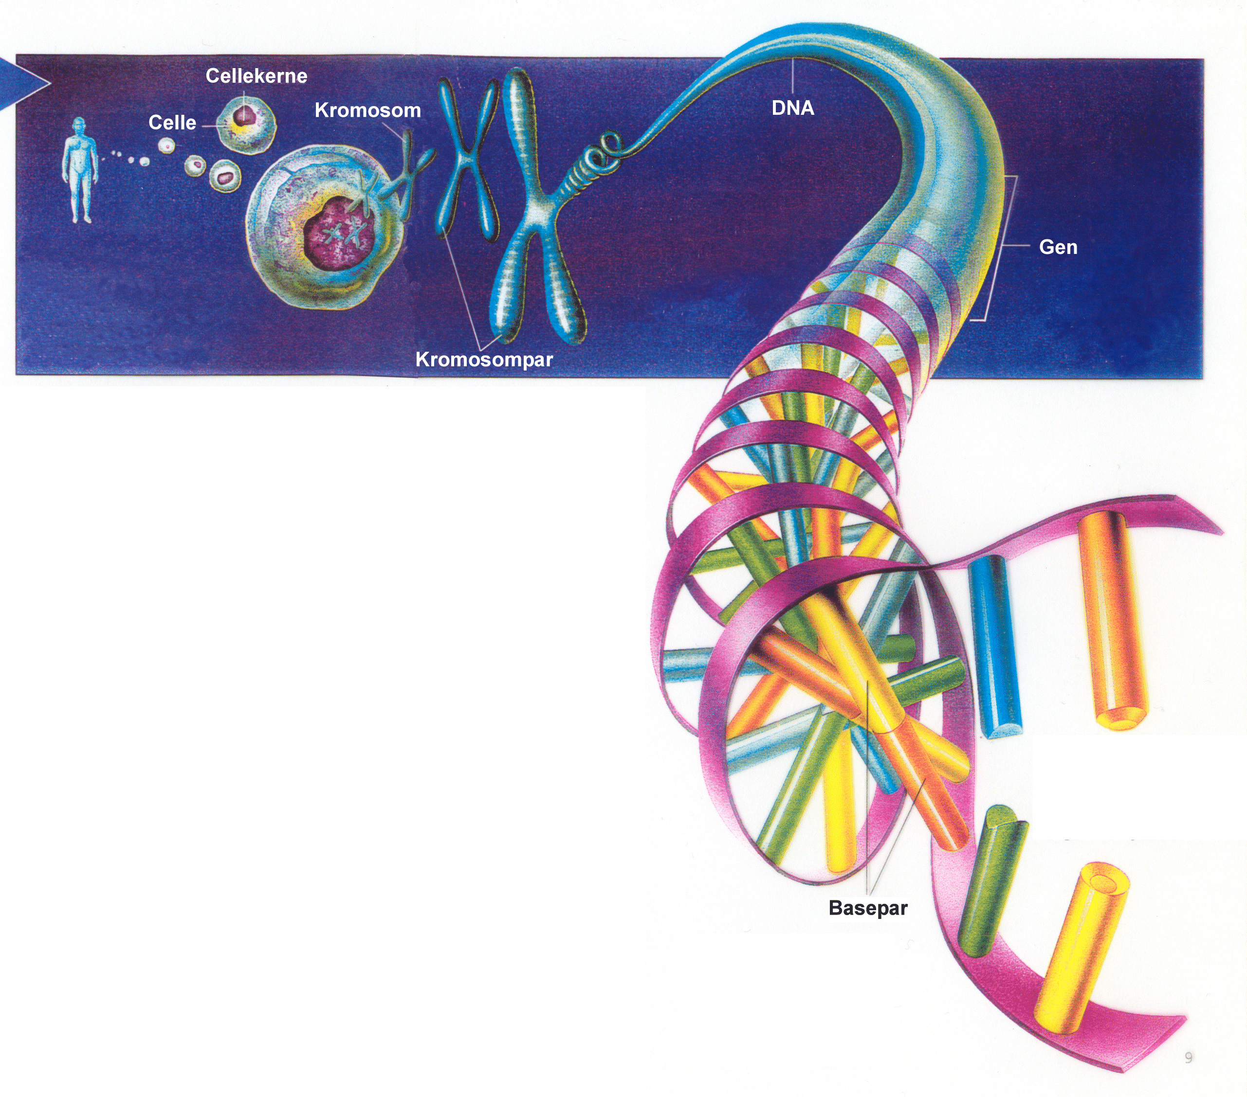
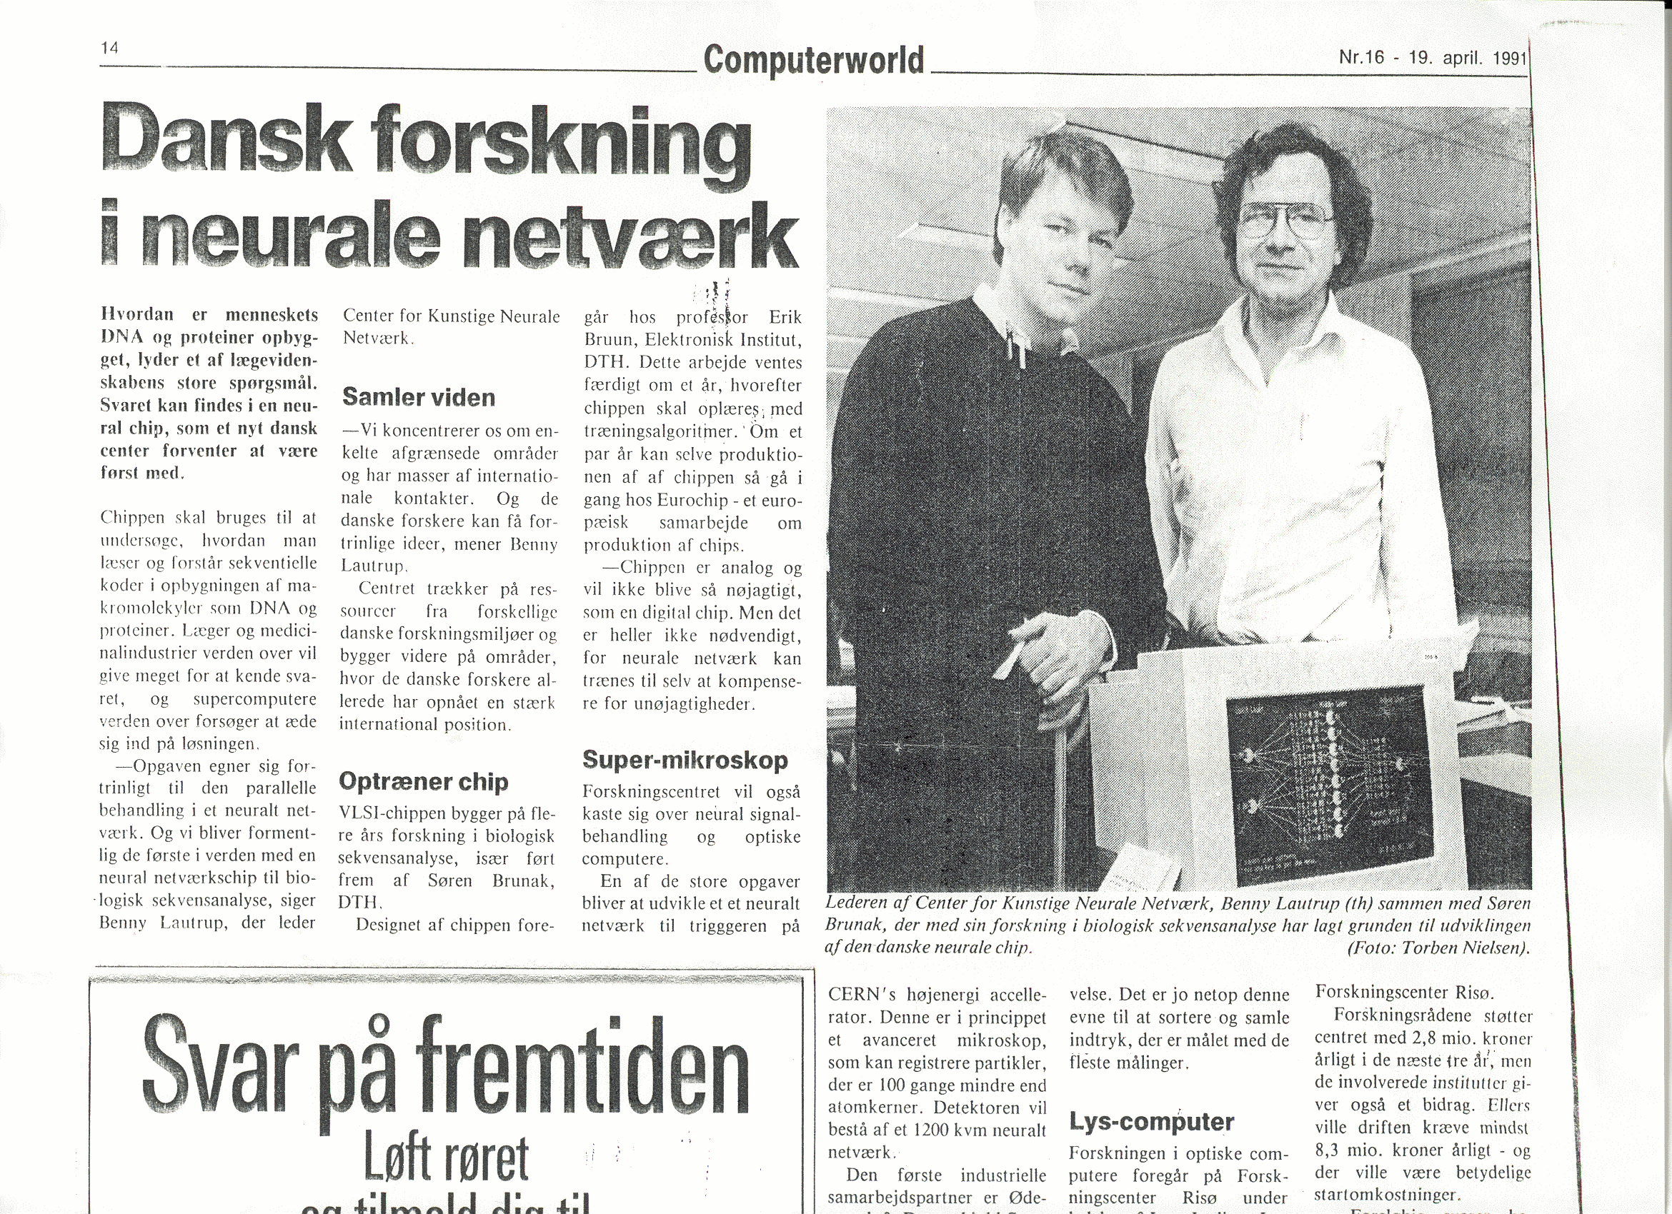
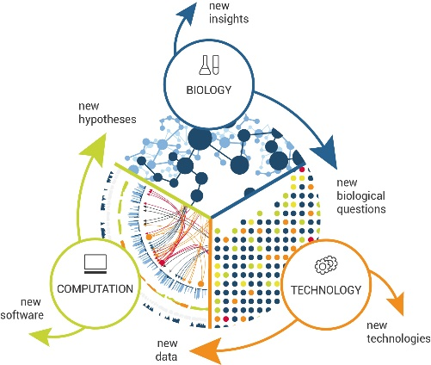
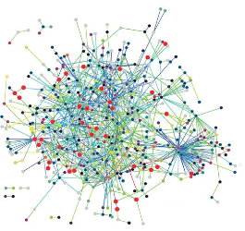
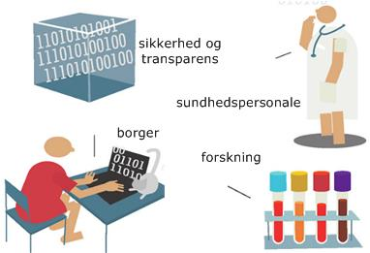
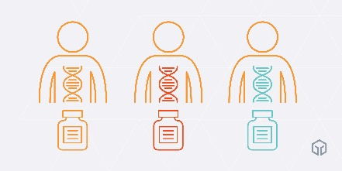
En bioinformatiker’s track-record
Biologisk sekvensanalyse
og neurale netværk
(1986-
Systembiologi,
genomer og proteomer
(2000-
Sundhedsdata
og personlig medicin
(2007-

Slide 3
Algoritmer inspireret af hjernens måde at behandle information på: Kunstige neurale netværk
Fjodor van Veen, Asimov Institute
Notes:
Neural networks are a class of machine learning models that are inspired by biological neural networks.
Learning a mapping from input to output space.
Also called feed-forward neural network, perceptron feeds information from the front to the back. Training perceptrons usually requires back-propagation, giving the network paired datasets of inputs and outputs. Inputs are sent into the neuron, processed, and result in an output. The error being back propagated is often some variation of the difference between the input and the output. Given that the network has enough hidden neurons, it can theoretically always model the relationship between the input and output.
Convolutional Neural Networks - images
Convolutional Neural Networks are quite different from most other networks. They are primarily used for image processing but can also be used for other types of input such as as audio. A typical use case for CNNs is where you feed the network images and the network classifies the data. CNNs tend to start with an input “scanner” which is not intended to parse all the training data at once. For example, to input an image of 100 x 100 pixels, you wouldn’t want a layer with 10 000 nodes. Rather, you create a scanning input layer of say 10 x 10 which you feed the first 10 x 10 pixels of the image. Once you passed that input, you feed it the next 10 x 10 pixels by moving the scanner one pixel to the right.
This input data is then fed through convolutional layers instead of normal layers, where not all nodes are connected to all nodes. Each node only concerns itself with close neighboring cells. These convolutional layers also tend to shrink as they become deeper
Recurrent Neural Networks - sequences
are basically perceptrons; however, unlike perceptrons which are stateless, they have connections between passes, connections through time. RNNs are very powerful, because they combine 2 properties: 1) distributed hidden state that allows them to store a lot of information about the past efficiently; and 2) non-linear dynamics that allows them to update their hidden state in complicated ways.
One big problem with RNNs is the vanishing (or exploding) gradient problem where, depending on the activation functions used, information rapidly gets lost over time
long-short term memory networks (LSTMs)
LSTMs networks try to combat the vanishing / exploding gradient problem by introducing gates and an explicitly defined memory cell. The memory cell stores the previous values and holds onto it unless a “forget gate” tells the cell to forget those values. LSTMs also have a “input gate” which adds new stuff to the cell and an “output gate” which decides when to pass along the vectors from the cell to the next hidden state. Put another way, we want to remember stuff from previous iterations for as long as needed, and the cells in LSTMs allow this to happen. LSTMs have been shown to be able to learn complex sequences, such as writing like Shakespeare or composing primitive music.
Gated recurrent units (GRUs) are a slight variation on LSTMs. In most cases, GRUs function very similarly to LSTMs, with the biggest difference being that GRUs are slightly faster and easier to run (but also slightly less expressive).
A Hopfield network (HN) is a network where every neuron is connected to every other neuron; it is a completely entangled plate of spaghetti as even all the nodes function as everything. Each node is input before training, then hidden during training and output afterwards. The networks are trained by setting the value of the neurons to the desired pattern after which the weights can be computed.
A Boltzmann Machine is a type of stochastic recurrent neural network. It can be seen as the stochastic, generative counterpart of Hopfield nets. It was one of the first neural networks capable of learning internal representations, and is able to represent and solve difficult combinatoric problems.
Deep Belief Networks can be trained through contrastive divergence or back-propagation and learn to represent the data as a probabilistic model. Once trained or converged to a stable state through unsupervised learning, the model can be used to generate new data. If trained with contrastive divergence, it can even classify existing data because the neurons have been taught to look for different features.
Autoencoders are neural networks designed for unsupervised learning, i.e. when the data is not labeled. As a data-compression model, they can be used to encode a given input into a representation of smaller dimension. A decoder can then be used to reconstruct the input back from the encoded version. The work they do is very similar to Principal Component Analysis, which is generally used to represent a given input using less number of dimensions than originally present. Autoencoders do similar work — the difference being that they can use non-linear transformations to encode the given vector into smaller dimensions (as compared to PCA which is a linear transformation). So it can generate more complex encodings. They can be used for dimension reduction, pretraining of other neural networks, for data generation etc. There are a couple of reasons: (1) They provide flexible mappings both ways, (2) the learning time is linear (or better) in the number of training cases, and (3) the final encoding model is fairly compact and fast. However, it turned out to be very difficult to optimize deep auto encoders using back propagation. With small initial weights, the back propagated gradient dies. Nowadays they are rarely used in practical applications, mostly because in key areas for which they where once considered to be a breakthrough (such as layer-wise pre-training), it turned out that vanilla supervised learning works better.
Generative Adversarial Networks (GANs) consist of any two networks (although often a combination of Feed Forwards and Convolutional Neural Nets), with one tasked to generate content (generative) and the other has to judge content (discriminative). The discriminative model has the task of determining whether a given image looks natural (an image from the dataset) or looks like it has been artificially created. The task of the generator is to create natural looking images that are similar to the original data distribution. The generator is trying to fool the discriminator while the discriminator is trying to not get fooled by the generator. As the models train through alternating optimization, both methods are improved until a point where the “counterfeits are indistinguishable from the genuine articles”.

Slide 4
Fem nedslagspunkter
Der har været arbejdet på at udvikle denne type algoritmer i mere end 30 år
Algoritmerne kan integrere data som mennesker har svært ved at overskue
Nye og bedre krav til “replikation” og hvad replication i “nye data” vil sige
Sundhedsdata er nu elektroniske og erkendt nødvendige for at udvikle metoder som komplementerer det sundhedspersonale allerede kan
Berøringsangsten overfor sekundær brug af sundhedsdata er stadig et problem på trods af at metoder til at beskytte data i lukkede systemer aldrig har været bedre
Fjodor van Veen, Asimov Institute

Slide 5
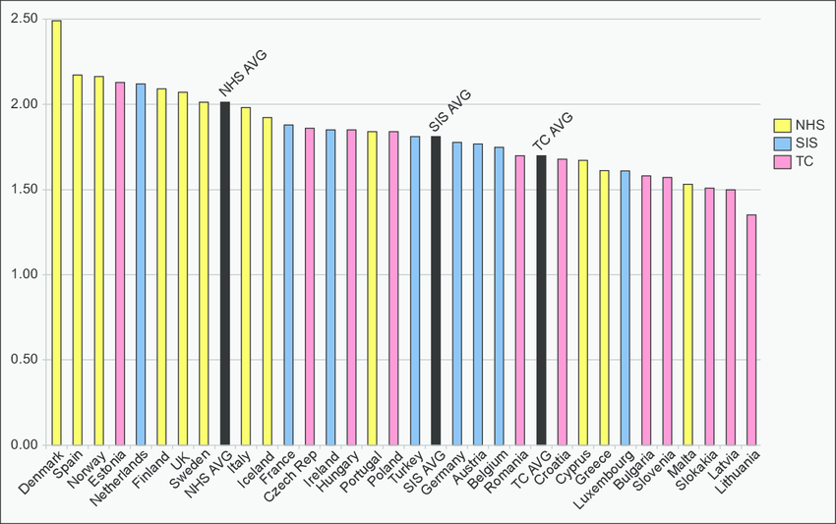
Sundhedssystemernes finansieringsmodel og graden af “elektroniskhed” – eHealth
Three national health models in Europe:
National Health Service (NHS) model
Social insurance system (SIS) model
Transition country (TC) model
Strong correlation between the NHS model and high adoption rates for eHealth.
Brennan, James & Mcelligott, Annette & Power, Norah. (2015). National Health Models and the Adoption of E-Health and E-Prescribing in Primary Care – New Evidence from Europe. Journal of Innovation in Health Informatics. 22. 399-408. 10.14236/jhi.v22i4.97.

